Slide 1

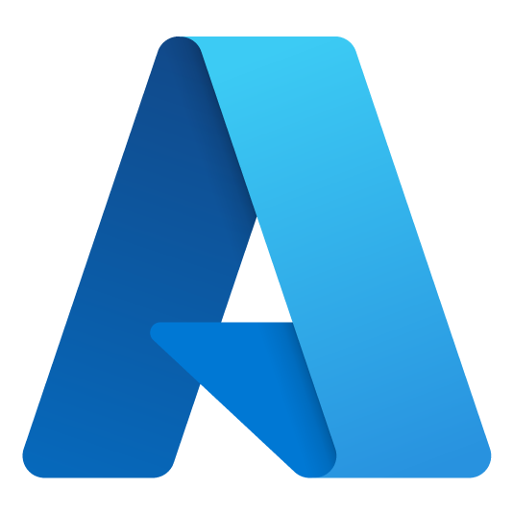



Chris McKee
Customer Success Account Manager – Developer
Azure Dev Day
chrismckee@microsoft.com
https://www.linkedin.com/in/chris-m-mckee/
https://github.com/ChrisMcKee1
Notes:
Introduce yourself

Slide 2

Walid Amro
Cloud Solution Architect
Azure Dev Day
walid.amro@microsoft.com
https://www.linkedin.com/in/walidamro/
https://github.com/walidamro-msft
Notes:
Introduce yourself

Slide 3

Luis Caligaris Garcia
Cloud Solution Architect
Azure Dev Day
lucali@microsoft.com
www.linkedin.com/in/lcaligaris
https://github.com/caligaris

Slide 4

Web Solutions
Building resilient, web-based solutions on Azure with Azure App Service

Slide 5
Java (Spring)
.NET
Node.js
PHP
Ruby on Rails
Python
(Container)
How do I host a
web app in Azure?
Notes:
Let’s ask ourselves the question… How do I host my web app in Azure?
There is more than one service that can provide app hosting.
Today we will cover Azure App Service.
The platform supports a lot of different native web frameworks and languages.
If App Service doesn’t support what you use out-of-the box (like a Golang Gin App),
Or if you prefer to containerize your web apps. There is also an option to host containerized apps on App Service

Slide 6


Web solution architecture
Azure App Service
Web App
Database
File Storage
Azure SQL Database
Azure Storage Account
Notes:
Let’s take a look at a standard web solution. This solution might have
A server-side app
A database
And file storage
Well, Hosting this solution in Azure could look like this
Azure App Service for hosting the web app
Azure SQL Database for hosting the database
Azure Storage Account Blob Containers for hosting the files

Slide 7
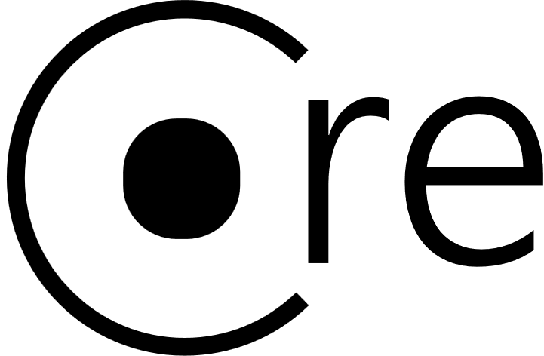


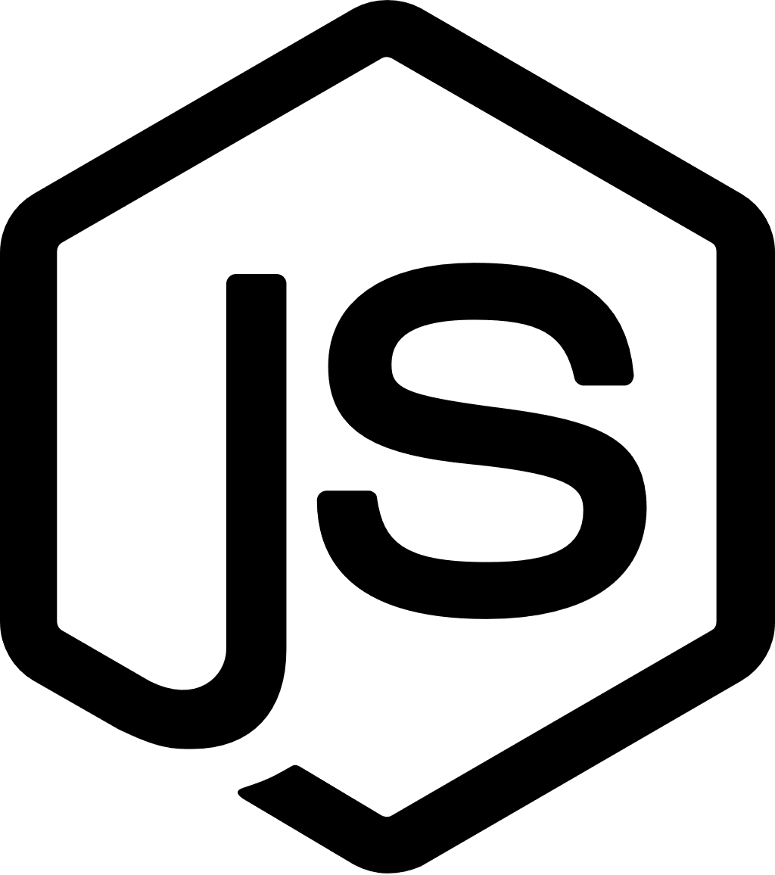


Azure App Service
App Service
(Web App)
App Service Plan
Notes:
An App Service sometimes called a Web App and is hosted on an App Service Plan
Each App Service Plan is a set of virtual machines (called instances)
Each App Service hosted on an App Service Plan has an instance of the app running on each instance in the plan
Requests to an App Service get load-balanced across all instances in the plan
The App Service Plan has specific computing sizes to choose from (called a sku)
App Service Plans can host either Linux or Windows VMs
Multiple App Services can run on a single App Service Plan
Each App Service could host a different web app language/framework as long as it works on the OS.
The OS is set at the App Service Plan whereas the language/framework is set at the web app.

Slide 8
Scale Out/Up
Scale Out
(Instance)
App Service (Web App A)
App Service (Web App B)
Instance 1
Instance 2
Instance 3
Scale Up
(SKU)
App Service Plan
Notes:
One of the feature of Azure App Service that we will talk about is scaling. There are 2 type of scaling methods, Automated or Manual.
If you setup up the automated scaling, then the app plan will add or remove instances bases on load characteristics (like CPU or memory utilization).
On the other hand, manual says it all. You can manually increase or decrease instance count to set the instance size.
If you look at the diagram on screen you will see if you scale out (adding instances) all apps in the plan will scale across all instances. If you scale up (adding resources like CPU and Memory) all app scale to use those new resources. So, simply said, All apps in the same App Service Plan share instances and compute power.
One question you should ask yourself is …
Should I put an app in a new plan or an existing plan?
You should Isolate your app into a new App Service plan when:
The app is resource-intensive. Or
You want to scale the app independently from the other apps in the existing plan. Or lastly
The app needs resource in a different geographical region.

Slide 9

Deployments
Non-Production Environment
Production Environment
Swap
(Production Slot)
(Staging Slot)
(Production Slot)
App Settings:
{
“apiUrl”: “https://non-prod.api.com”,
“senderEmail”: “devteam@company.com”
}
App Settings:
{
“apiUrl”: “https://prod.api.com”,
“senderEmail”: “us@company.com”
}
Notes:
Now let us talk about deployments.
You can use a build and deployment pipeline like
GitHub
Azure DevOps
Jenkins
or a CLI
So how would that look. If you deploy out to non-prod environment
You get App Settings that is used to set per-app-service environment settings that are Injected as environment variables
Now we deploy our app to production, and we see that Prod has its own app settings.
There is another feature called Deployment slots. Normally you only do this in your prod environment. Let's look at an example slot deployment set up for prod.
You would have 2 slot, one for Staging and one for the live prod app.
Deploy to a “staging” slot in your production environment. Allows you to warm the app up and validate the application is ready.
Then you can swap the applications deployed in the staging & prod slots
Essentially 0 downtime for users and now the old prod slot become staging, and the old app is readily available if you need to back out the deployment and revert to the previous status if something goes wrong.

Slide 10












Additional Services
Private
Link
API Management
Traffic
Manager
App
Gateway
Front
Door
Virtual Network
Application
Insights
Key Vault
App Service
Log
Analytics
Azure
SQL
PostgreSQL
Cosmos
Redis
Cache
Storage
Account
Notes:
Let’s talk about some additional services that are typically used with App Service.
Routing and ingress
Private Link – Lock down ingress to an IP address in your private Vnet
API Management – Expose APIs to consumers, perform routing and translation, set rate limits
Traffic Manager – DNS based regional traffic routing
App Gateway – Layer 7 (route based) traffic routing and Web Application Firewall
Front Door – Traffic Manager and App Gateway together
Data persistence
Relational Offerings
Azure SQL the PAAS offering of SQL Server
Azure Database for PostgreSQL (also MySQL or MariaDB)
Cosmos – Non-relational database with API facades for Core SQL, Mongo, Cassandra, Gremlin, and a Table API
Storage account – BLOB (file) storage
Security
Virtual Network – Protect and access resources in a private network
Key Vault – Store sensitive encryption keys, application secrets, or certificates
Observability
Application Insights – Application Performance Monitoring and logging
Log Analytics – Log ingestion (backing store for App Insights)

Slide 11
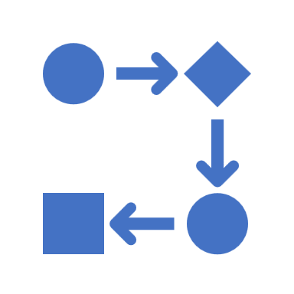


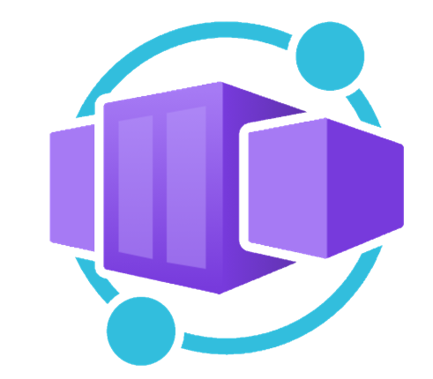



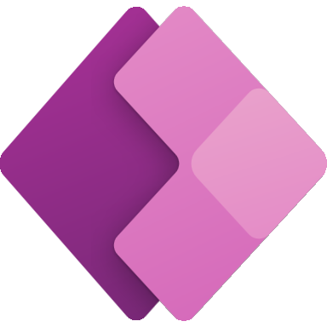
Application hosting continuum
IaaS
Infrastructure Platform
CaaS
Container Orchestration
Platform
PaaS
Application Platform
FaaS
Serverless Platform
Low Code
App and Orchestration
Platform
Virtual Machines
Azure Kubernetes
Service
Azure Container Apps
Azure Spring Apps
Azure App
Service
Azure Functions
Azure Logic
Apps
Power Apps
More Control of execution environment
Less Control of execution environment
Less Agile development & deployment
More Agile development & deployment

Slide 12

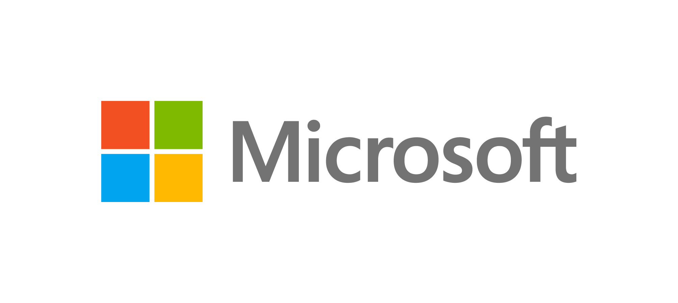
Sign up for Microsoft.Source
Thank you!
Receive a regular digest of relevant technical content, events and training
Get the best of the newest resources, tools and guidance to help developers quickly build and deploy on Azure
Please fill out the Azure Dev Day Survey!
aka.ms/azuredevdaysurvey
And visit our event content page to access lab materials, presentations and more about the Microsoft Build Conference!
aka.ms/azuredevdaycontent
Get the latest articles, documentation, and events from Microsoft.Source—the curated monthly developer community newsletter.
Stay at the forefront of rapidly evolving technologies with resources that are relevant to your field, location, and areas of interest—including articles, GitHub repositories, and how-to guides.
Get notified about events—from local hacks, workshops, and training sessions to virtual meetups and global conferences.
Learn what you want, when you want, how you want. Resources include in-person hands-on workshops, free, interactive online training and sandbox environments.

Slide 13
Web Solutions Lab
Azure App Service
Azure SQL Database
aka.ms/azuredevdaylabs/web
Azure Dev Day
Notes:
Feel free to mute me and work on the lab by yourself
I’m going to walk through the lab step-by-step if you want to follow along

